Slide 1
HR Attrition Analysis Dashboard
Yash Waingankar
Business Analyst | Data Analyst
Power BI | DAX

Slide 2
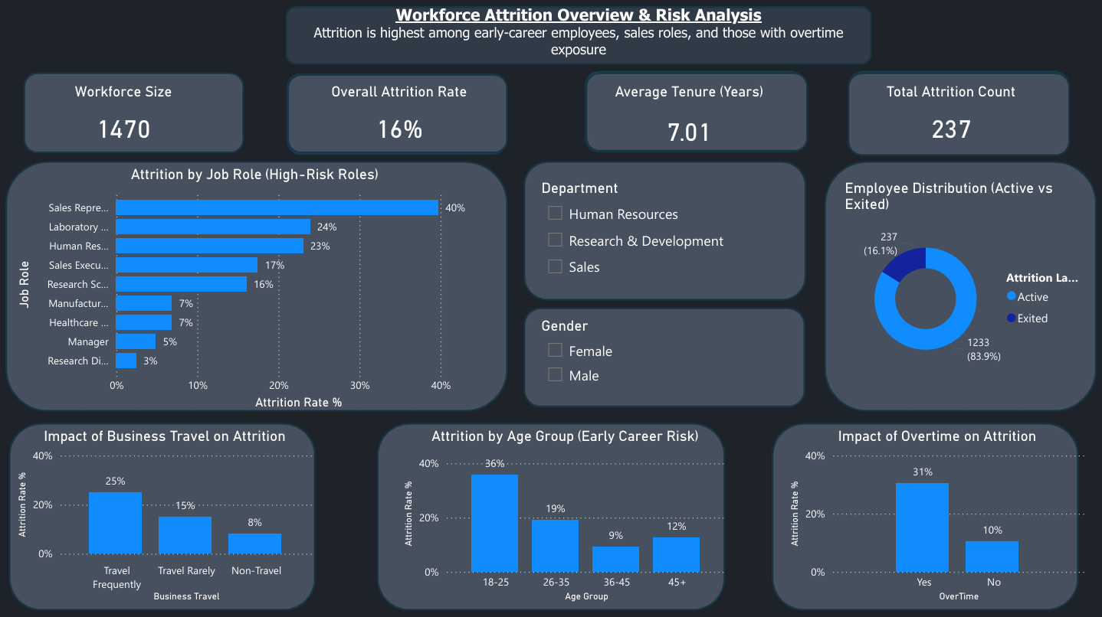

Slide 3
Business Problem
High employee attrition impacts cost, productivity, and workforce stability.
Lack of visibility into why employees leave.
Difficulty in identifying high-risk roles and segments.
🎯 Enable data-driven HR decision-making.

Slide 4
Key Metrics
Total Employees: 1470
Attrition Count: 237
Attrition Rate: 16%
Average Tenure: 7.01 years

Slide 5
Key Insights
Sales roles show highest attrition (~40%).
Employees with overtime have higher attrition (31% vs 10%).
Frequent business travel increases attrition (25% vs 8%).
Age group 18–25 shows highest attrition (36%).
Early-career employees + high workload = high attrition risk.

Slide 6
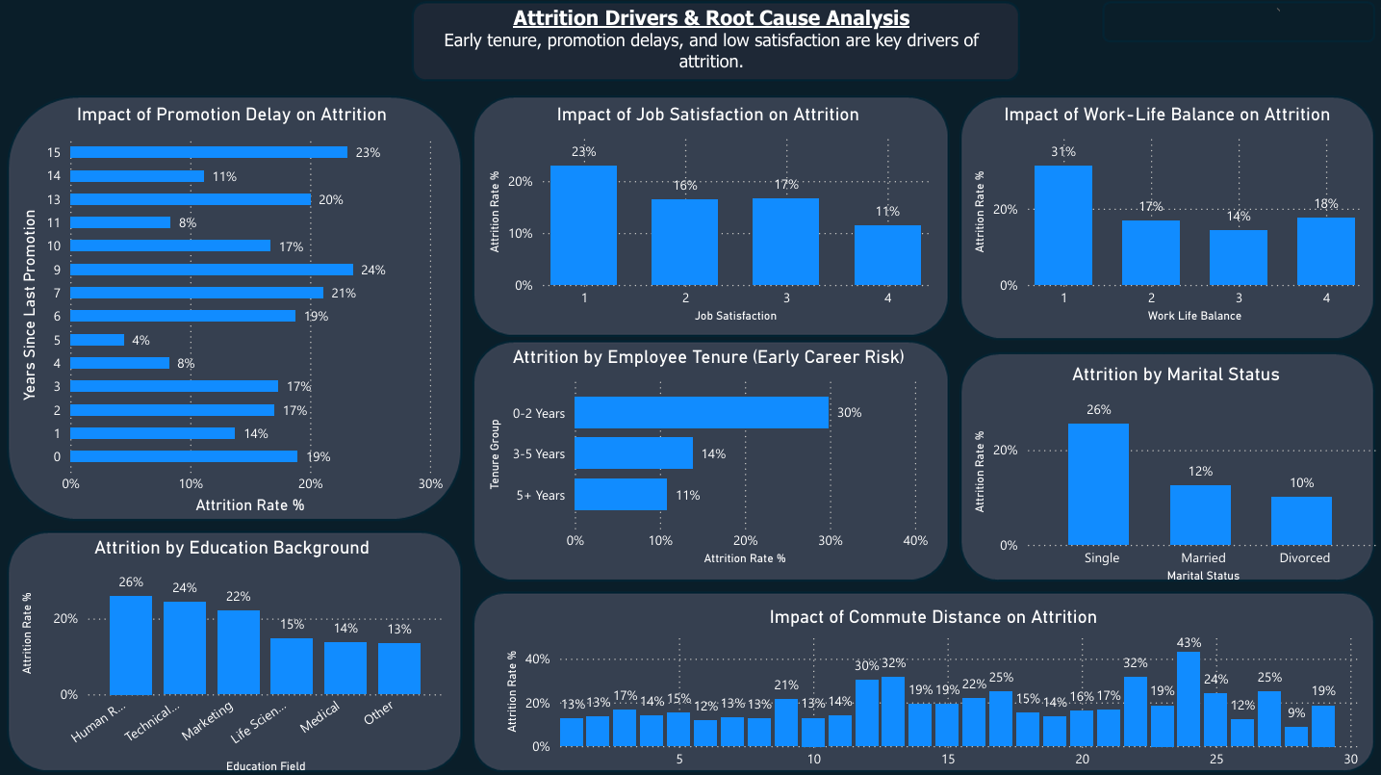

Slide 7
Key Drivers of Attrition
Early tenure (0–2 years) has highest attrition (30%).
Low job satisfaction leads to higher employee exits.
Poor work-life balance increases attrition risk.
Promotion delays contribute to employee turnover.
Long commute distance increases likelihood of attrition.
Attrition is multi-factor driven.

Slide 8
Business Recommendations
Improve onboarding and early employee engagement.
Reduce excessive overtime workload.
Implement timely promotion cycles.
Enhance work-life balance policies.
Offer flexible work options for long-distance employees.
Focus on proactive employee retention strategies.

Slide 9
Conclusion
Attrition is influenced by:
Work conditions
Employee satisfaction
Career growth opportunities
Dashboard enables:
Risk identification
Data-driven decision-making
Shift from reactive HR management → proactive retention strategy

Slide 10
Tools & Skills
Power BI
DAX (Data Analysis Expressions)
Data Visualization
Data Analysis
HR Analytics

